Slide 1
Towards a Common Simulation for Hover Validation of a Helicopter near the Ground Plane
Dr. Robert Narducci, The Boeing Company, Philadelphia, PA 19142
Dr. Nathan Hariharan, HPCMP CREATE™ Technical Operations, Lorton, VA, 22079
SCITECH 2023 | National Harbor, MD | January 23-27, 2023
https://www.aiaa-hpw.org

Slide 2
This Paper Covers…
Introduction and Objectives
Hover Focus Problem 1
Sample Results including:
  The Approach
  HOGE Assessment
  HIGE Assessment
Summary and Conclusions

Slide 3
Introduction
10 years of AIAA Hover Prediction Workshop papers have contributed in 3 broad areas
  Fundamental process development
  Verification and validation
  Applications
Grand Challenge Problem

Slide 4
Objective
High quality, real-world, detailed data sets are not widely available to the general public… so let’s make some ourselves!
The HPW steering committee will be inventing a series of hover problems for enthusiasts to solve using their best practices
Results are intended to be shared for code-to-code comparisons

Slide 5
Hover Focus Problem 1: Overview
Hover Focus Problem #1 is a deep-dive into “real” hover simulations of a rotorcraft in the proximity of a ground plane.
Several aspects of the problem are described in 7 sections
The intention is for practitioners to work through sections of their interest – 1 or more at a time – but not necessarily all at once!
Practitioners are encouraged to share results for comparison with helicopter enthusiasts across the globe

Slide 6
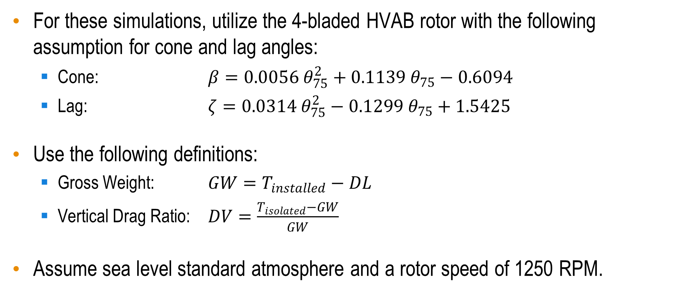
Hover Focus Problem 1: Overview (Continued)
For these simulations, utilize the 4-bladed HVAB rotor with the following assumption for cone and lag angles:
  Cone: $β=0.0056{ θ}_{75}^{2}+0.1139{ θ}_{75}−0.6094$
  Lag: $ζ=0.0314{ θ}_{75}^{2}−0.1299 θ_{75}+1.5425$
Use the following definitions:
  Gross Weight: $GW=T_{installed}−DL$
  Vertical Drag Ratio: $DV=\frac{T_{isolated}−GW}{GW}$
Assume sea level standard atmosphere and a rotor speed of 1250 RPM.

Slide 7
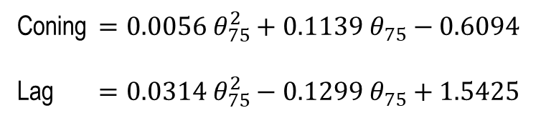
HVAB Rotor & Robin Mod7
Blade Number | 4
Radius | 66.5 in
Solidity | 0.1033
Reference Chord | 5.45 in
Tip Chord | 3.27 in
Tip Sweep | 30 deg at 95% R
Flap Hinge | 3.5 in
Rotor Speed | 1250 RPM
Tip Mach Number | 0.65 @ SLS
Coning $=0.0056{ θ}_{75}^{2}+0.1139{ θ}_{75}−0.6094$
Lag $=0.0314{ θ}_{75}^{2}−0.1299 θ_{75}+1.5425$
Utilize the Robin-Mod7 fuselage as integrated by Overmeyer and Martin without the main rotor pylon (AIAA 2017-1872)

Slide 8
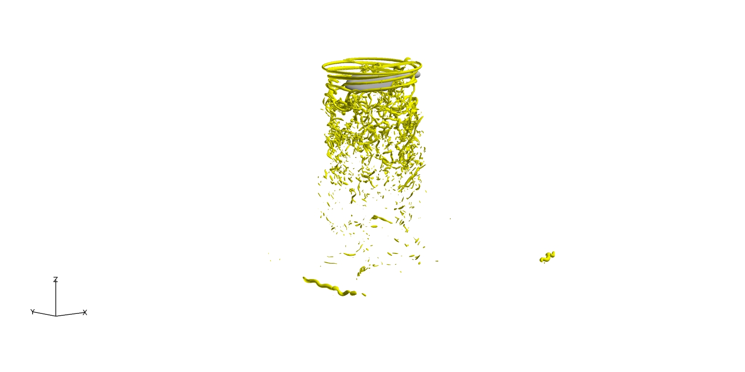
Hover Focus Problem 1: Overview (Continued)
1. HOGE Assessment
2. HIGE Assessment
3. Groundwash Assessment – Part 1
4. Groundwash Assessment – Part 2
5. Impact of Headwinds
6. Generalized Impact of Wind
7. Descent Simulation

Slide 9
Sample Results
Approach to Results
HOGE Assessment
HIGE Assessment

Slide 10
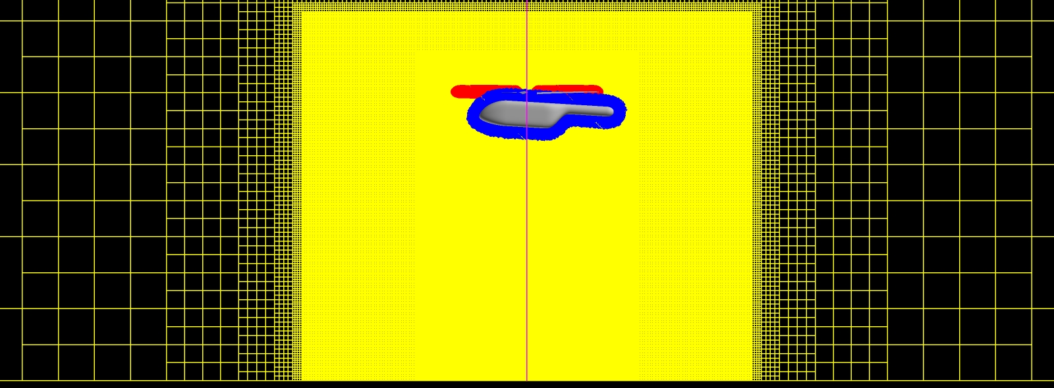
Approach
CREATE™-AV Helios V11 with
  Overflow 2.3b (blades)
  KCFD (airframe)
  SAMCART (field)
SA DDES
0.5°rotor rotation per
time step
0.52”

Slide 11
HOGE Assessment

Slide 12
HOGE Assessment
r/R = 0.973

Slide 13
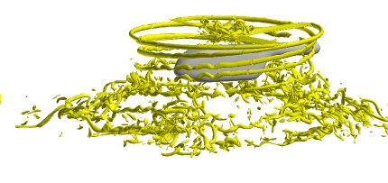
HIGE Assessment
h/D = 0.5

Slide 14
HIGE Assessment
GW = 1,000lbs
r/R = 0.973

Slide 15
HIGE Assessment
Thrust and power for the installed HVAB rotor as a function of rotor height above the ground, N.R. = 1250 RPM, GW = 1,000lbs

Slide 16
Summary and Conclusions
The Hover Focus Problem 1 is an attempt by the Steering Committee to challenge hover simulation enthusiasts to benchmark their processes for a calculation that includes aspects of the 2030 Grand Challenge Problem.
  It is an extension of the isolated HVAB rotor in hover
  The problem is segmented into seven sections. Practitioners can participate in some or all of the sections
  Sections cover hover installation effects, interactions with the ground, the impact of winds, and a descent maneuver.

Slide 17
Summary and Conclusions
Sample results of Steps 1, 2, and 3 using CREATE™-AV Helios are presented in this paper. Results indicate that
  the download-to-thrust ratio varies with thrust and is 4.8% at the targeted gross weight of 1,000 lbs (HOGE).
  an installation benefit in rotor performance of approximately 0.01 in FM
  the airframe causes the rotor to produce approximately 17 lbs more thrust, recovering 30% of the download.
  the rotor begins to feel the presence of the ground between h/D = 1.5 and 2.0.
  The assessment of groundwash is a work in progress.
The Hover Focus Problem 1 is extensive and much work remains. The Steering Committee will continue to utilize Helios to produce results for comparison.

Slide 18
I Hope you Enjoy the Paper and the Conference!

Slide 19
The Backups

Slide 20
Hover Focus Problem 1: Overview (Continued)
1. HOGE Assessment
2. HIGE Assessment
3. Groundwash Assessment – Part 1
4. Groundwash Assessment – Part 2
5. Impact of Headwinds
6. Generalized Impact of Wind
7. Descent Simulation

Slide 21
The 10 Minute Version

Slide 22
Towards a Common Simulation for Hover Validation of a Helicopter near the Ground Plane
Dr. Robert Narducci, The Boeing Company, Philadelphia, PA 19142
Dr. Nathan Hariharan, HPCMP CREATE™ Technical Operations, Lorton, VA, 22079
SCITECH 2023 | National Harbor, MD | January 23-27, 2023
https://www.aiaa-hpw.org

Slide 23
Introduction
10 years of AIAA Hover Prediction Workshop papers have contributed in 3 broad areas
  Fundamental process development
  Verification and validation
  Applications
Grand Challenge Problem

Slide 24
Hover Focus Problem 1: Overview
Hover Focus Problem #1 is a deep-dive into “real” hover simulations of a rotorcraft in the proximity of a ground plane.
Several aspects of the problem are described in 7 sections
The intention is for practitioners to work through sections of their interest – 1 or more at a time – but not necessarily all at once!
Practitioners are encouraged to share results for comparison with helicopter enthusiasts across the globe

Slide 25
Hover Focus Problem 1: Overview (Continued)
1. HOGE Assessment
2. HIGE Assessment
3. Groundwash Assessment – Part 1
4. Groundwash Assessment – Part 2
5. Impact of Headwinds
6. Generalized Impact of Wind
7. Descent Simulation

Slide 26
Approach
CREATE™-AV Helios V11 with
  Overflow 2.3b (blades)
  KCFD (airframe)
  SAMCART (field)
SA DDES
0.5°rotor rotation per
time step
0.52”

Slide 27
HOGE Assessment

Slide 28
HOGE Assessment
r/R = 0.973

Slide 29
HIGE Assessment
h/D = 0.5

Slide 30
HIGE Assessment
r/R = 0.973

Slide 31
HIGE Assessment
Thrust and power for the installed HVAB rotor as a function of rotor height above the ground, N.R. = 1250 RPM, GW = 1,000lbs

Slide 32
Summary and Conclusions
The Hover Focus Problem 1 is an attempt by the Steering Committee to challenge hover simulation enthusiasts to benchmark their processes for a calculation that includes aspects of the 2030 Grand Challenge Problem.
  It is an extension of the isolated HVAB rotor in hover
  The problem is segmented into seven sections. Practitioners can participate in some or all of the sections
The Hover Focus Problem 1 is extensive and much work remains. The Steering Committee will continue to utilize Helios to produce results for comparison.

Slide 33
I Hope you Enjoy the Paper and the Conference!

Slide 34
Hover Focus Problem 1: Overview (Continued)
Step 1: HOGE Assessment
Step 2: HIGE Assessment
Step 3: Groundwash Assessment – Part 1
Step 4: Groundwash Assessment – Part 2
Step 5: Impact of Headwinds
Step 6: Generalized Impact of Wind
Step 7: Descent Simulation

Slide 35
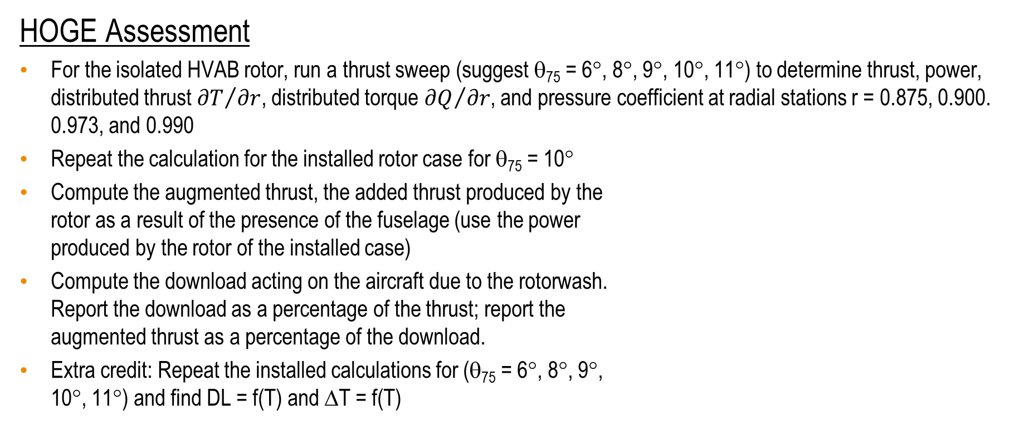
Hover Focus Problem 1: Step 1
HOGE Assessment
For the isolated HVAB rotor, run a thrust sweep (suggest θ₇₅ = 6°, 8°, 9°, 10°, 11°) to determine thrust, power, distributed thrust ${∂T}/{∂r}$, distributed torque ${∂Q}/{∂r}$, and pressure coefficient at radial stations r = 0.875, 0.900. 0.973, and 0.990
Repeat the calculation for the installed rotor case for θ₇₅ = 10°
Compute the augmented thrust, the added thrust produced by the
rotor as a result of the presence of the fuselage (use the power
produced by the rotor of the installed case)
Compute the download acting on the aircraft due to the rotorwash.
Report the download as a percentage of the thrust; report the
augmented thrust as a percentage of the download.
Extra credit: Repeat the installed calculations for (θ₇₅ = 6°, 8°, 9°,
10°, 11°) and find DL = f(T) and ΔT = f(T)

Slide 36
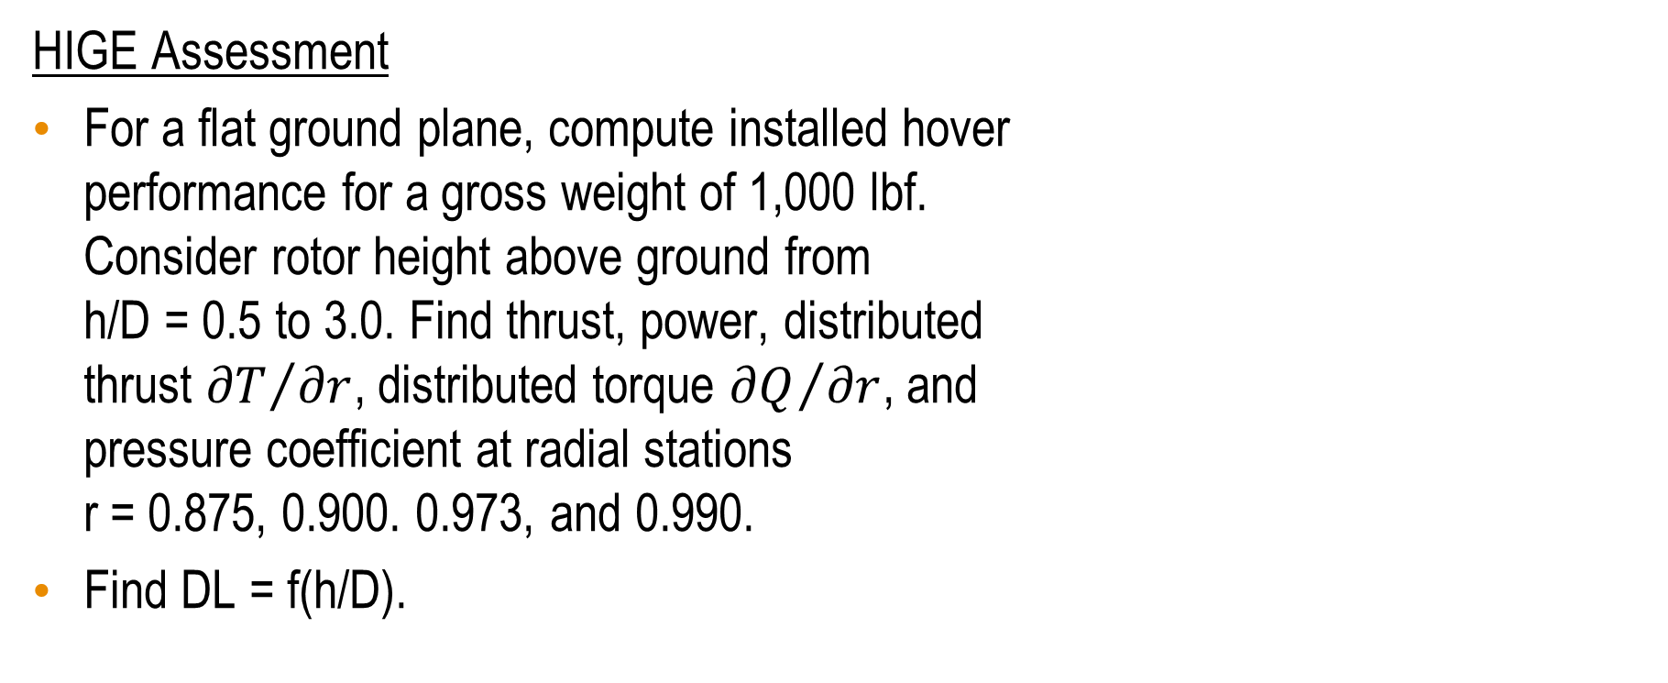
Hover Focus Problem 1: Step 2
HIGE Assessment
For a flat ground plane, compute installed hover
performance for a gross weight of 1,000 lbf.
Consider rotor height above ground from
h/D = 0.5 to 3.0. Find thrust, power, distributed
thrust ${∂T}/{∂r}$, distributed torque ${∂Q}/{∂r}$, and
pressure coefficient at radial stations
r = 0.875, 0.900. 0.973, and 0.990.
Find DL = f(h/D).

Slide 37
Hover Focus Problem 1: Step 3
Groundwash Assessment – Part 1
For a flat ground plane, compute the ground
wash for installed hover performance for a
gross weight of 1,000 lbf and a rotor height
above ground of h/D = 0.5. Note: this is one
of the cases in Step 2A.
Plot the ground velocity profile at azimuth
locations of 0, ±45°, 90°, ±135°, and 180°,
and radial locations of 0.5D, 1.0D, and 1.5D.
Extra Credit: How do the results of Step 3A differ for an isolated rotor?
h/D
V

Slide 38
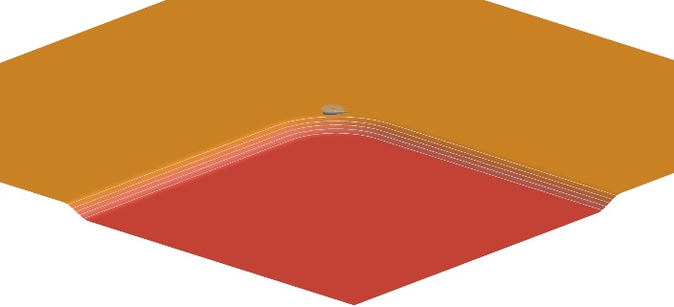
Hover Focus Problem 1: Step 4
Groundwash Assessment – Part 2
Repeat Step 3 with the hillside ground plane

Slide 39
Hover Focus Problem 1: Step 5
Impact of Headwinds
Repeat Step 3 with 3- and 6-knot headwinds. For this exercise, do not consider changes to rotor flapping or add cyclic for rotor trim. Instead, report changes to rotor forces and moments.

Slide 40
Hover Focus Problem 1: Step 6
Generalized Impact of Wind
Repeat Step 5 with 3- and 6-knot winds from ±45°, 90°, ±135°, and 180°

Slide 41
Hover Focus Problem 1: Step 7
Descent Simulation
Consider a descent from h/D = 2.0 to
h/D = 0.5 following the velocity profile
described by:
Keep gross weight constant (1,000 lbf)
and find T = f(t), P = f(t) and DL = f(t).
The simulation is 2.4 seconds long
requiring 50 rotor revolutions.
$$V = 6.9271 − 6.9271 × COS(π/1.2 × t)$$

